Slide 1
Relationship Between Short Rest And Injury

Slide 2
Dataset
In this report, we examine the relationship between short rest and injuries.
Definitions:
We define short rest as less than 7 days between matches
Soft tissue injury - muscle or ligament injury
Contact injury - break and fractures.

Slide 3
Dataset – Match data
Match data has been retrieved from Soccerway. Contains player information from spanning over 2012-2015.

Slide 4
Dataset – Injury Data
Injury data has been retrieved from Transfermarket. Contains information about the injury and start/end of the injury.

Slide 5
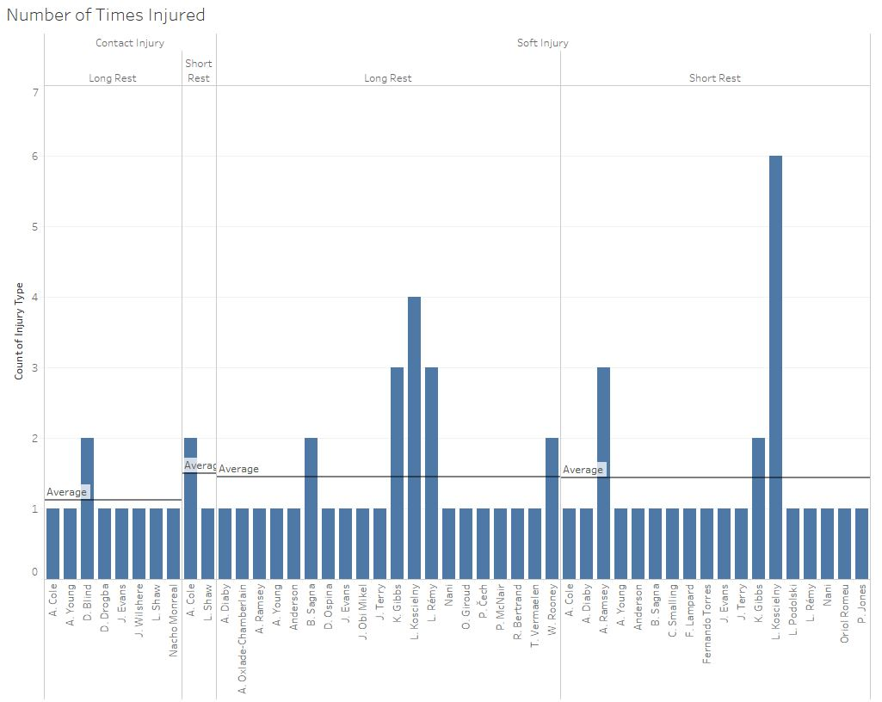
Soft Injury
The volume of long rest for the soft injuries are larger than the short injuries.
However the average number of soft injuries during long and short rest is the same
While this is a fairly small sample, we may be able to infer that rest duration does not significantly contribute to injury frequency.
Contact Injury
Once again, we see larger volumes for the long rest.
However averages favour short.

Slide 6
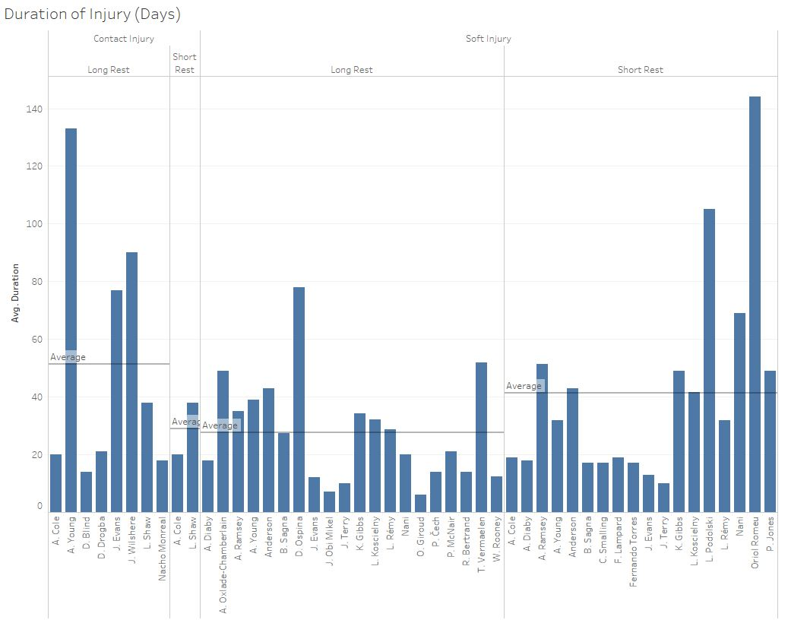
Soft Injury
We see higher average and volume of time spent in an injury state for short rest.
While the frequency of injuries may be similar, we see that more time is spent being injured when having short rests rather than long rests.
Contact Injury
Once again, we see larger volumes for the long rest.
However, the average also favours long rest. This is to be expected, as contact injuries are more likely to result in longer periods in an injured state.

Slide 7
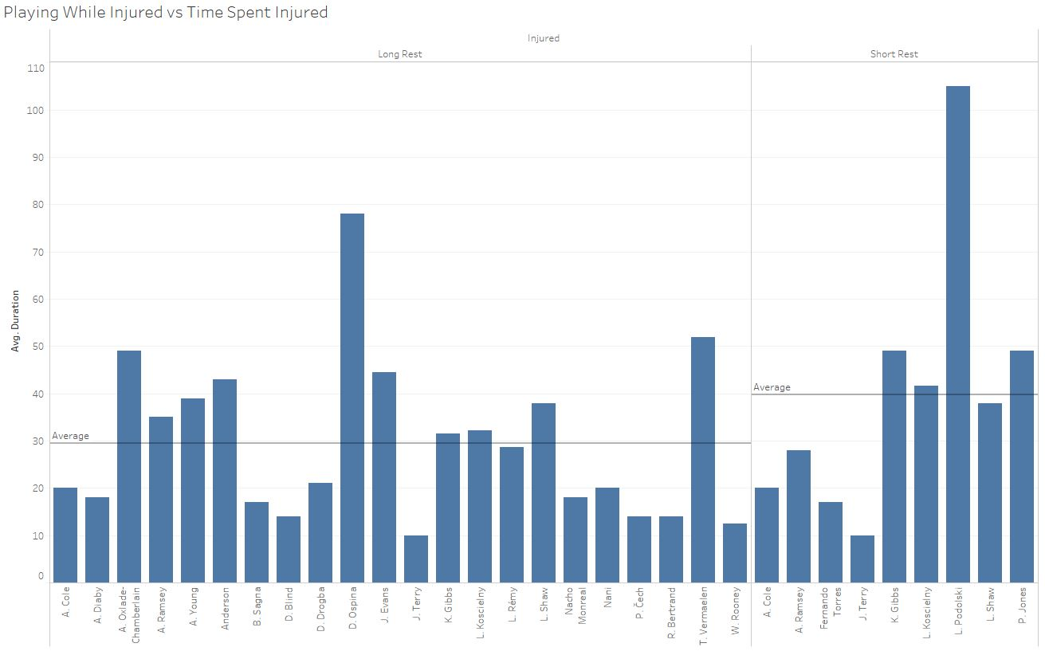
Playing While Injured
See a lower volume of players playing while injured on short rest. Is expected as playing injured players frequently is not ideal.
However the average time spent injured is higher than those who have a long rest.

Slide 8
Conclusion
After examining the data, we can summarize that:
Resting for a short or long period does not influence the frequency of injuries
However, more time is spent being injured when having short rests rather than long rests.
Playing while injured is not favourable on a short resting period, as we see more time spent being injured.

